Slide 1
Buffer Overflow
信息安全原理课程报告
第七组组员：蔡灿宇 张旭 李子航 张宇轩 马辰越 倪小淳 唐敏跃 杨锐洁 刘轩铭

Slide 2
01
Background Introduction
02
Exploitation
CONTENT
03
Countermeasures
04
Summary

Slide 3
What is buffer overflow?
Concept ------- When a program writes data to the buffer, it overflows the boundary of the buffer and overwrites the adjacent memory.
Exploitation------ Data and instructions are the same in memory. So attackers can overwrite legal data with carefully prepared code. With the control of program flow, they will finally make the attack code work.
Significance ----- In the network security vulnerabilities, the proportion of buffer overflow has been high. in the first half of 2017, the buffer overflow vulnerability attacks account for 14% among all attacks.

Slide 4
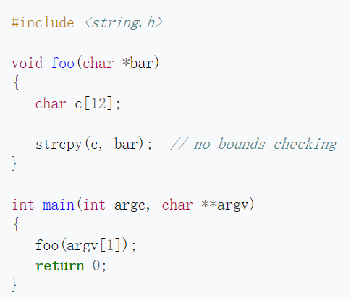
Stack Buffer Overflow
---The canonical method for exploiting a stack-based buffer overflow is to overwrite the function return address with a pointer to attacker-controlled data (usually on the stack itself).

Slide 5
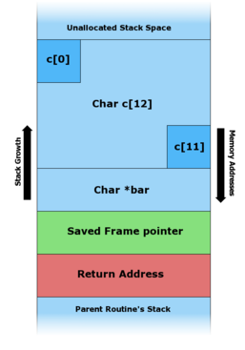
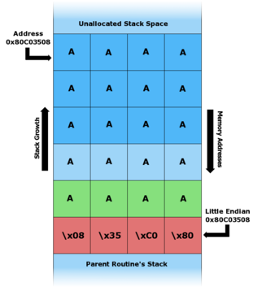
Stack Buffer Overflow

Slide 6
Stack Buffer Overflow
---In an actual stack buffer overflow exploit, the string of "A"'s would instead be malicious code.
---If this program had special privileges, then the attacker could easily gain superuser privileges
---If the address is unpredictable, you can jump to another intended address.
---Other methods like overwriting the local variable can also exploit some bugs in the program.

Slide 7
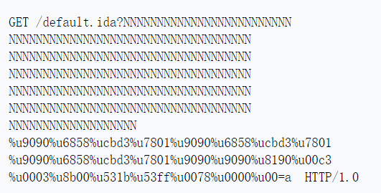
Buffer overflow attack instance
In 2001, Code Red worm----exploiting buffer overflow vulnerability in Microsoft IIS Web server to attack more than 300000 computers.
---The effective part of the worm is the string following the last ‘N’.
----Due to a buffer overflow, a vulnerable host interpreted this string as computer instructions, propagating the worm.

Slide 8
Other instances
In 2003 the SQL Slammer worm exploit buffer overflow to compromise machines running Microsoft SQL Server 2000.
In 2003, Blaster Worm spread on computers running operating systems Windows XP and Windows 2000
And the earliest one----Morris worm exploited a service on Unix called finger to propagate itself over the Internet.

Slide 9
Heap Buffer Overflow
Heap----Memory on the heap is dynamically allocated by the application at run-time and typically contains program data
Overflowing buffers on heap can change pointers that point to important data. Sometimes can cause program to crash by forcing it to read from an invalid address (segmentation violation)

Slide 10
A Display of Overflow Attack

Slide 11
Countermeasures
---Choice of programming language
---Use of safe libraries
---Address space layout randomization
---stack detection like Stack guard in gcc
---Non-executable stack

Slide 12
Summary
-- Buffer overflow is a common vulnerability in many software and systems, which is easy to be attacked by hackers.
-- Although buffer overflow attacks have been around for 30 years, and there are many ways to defend against them. As a qualified programmer, we must take precautions in our work

Slide 13
Thank you for attention！

